Slide 1
We will get started shortly.
International Science Nutrition Society – CURARE CAUSAM - ISNS 2023

Slide 2
ISNS CASE STUDY
With Dr. Norbert Ketskes on Multiple Sclerosis
International Science Nutrition Society – CURARE CAUSAM - ISNS 2023

Slide 3
Medical Disclaimer
The information provided is for educational purposes and is not intended as medical advice, or a substitute for the medical advice of a physician or other qualified health care professional. This is for science and educational purposes only and cannot be used in any aspect for sales or marketing. You should not use this information for diagnosing a health or fitness problem or disease. You should always consult with a doctor or other health care professional for medical advice or information about diagnosis and treatment. This is Confidential. Do not distribute—for scientific educational purposes only.
International Science Nutrition Society – CURARE CAUSAM - ISNS 2023

Slide 5
DR. NORBERT KETSKÉS, MD
Dr. Norbert Ketskés M.D. is one the most acknowledged gastroenterologist in Hungary, specializing in natural and organic nutritional solutions, leading the well-known Primus Labor, a private clinic offering personalized nutritional advices to its patients.
Scientific Adviser of ISNS
Independent Scientific Adviser of Rain International in Europe since 2013
Medical Partner of the Hungarian Olympic Committee since 2015
Member of the Medical board of Hungarian Karate Association since 2015
Leader of the Primus Labor Private Medical Clinic since 2013
Working as a Family Doctor 1999 – 2012
International Science Nutrition Society – CURARE CAUSAM - ISNS 2023

Slide 6
CSISZTU ZSUZSA
Television - Presenter, Anchor, Editor, Journalist and Sports Lawyer, Sport-diplomat
Spokesperson of the Giro d’Italia Grande Partenza, (Road-Cycling World -Tour Championship)
Spokesperson of the FINA (Swimming and Waters poets World Championship)
2022 Vice-President of the Hungarian Sports Journalists’ Association
Member of the Hungarian Olympic Committee Member of the Advisory Board of the Hungarian Olympic Academy
Newly Elected Vice-President of the International Sports Journalists Association, the first female ever in the field from her homeland, and third globally since 1924 (AIPS)
International Science Nutrition Society – CURARE CAUSAM - ISNS 2023

Slide 7
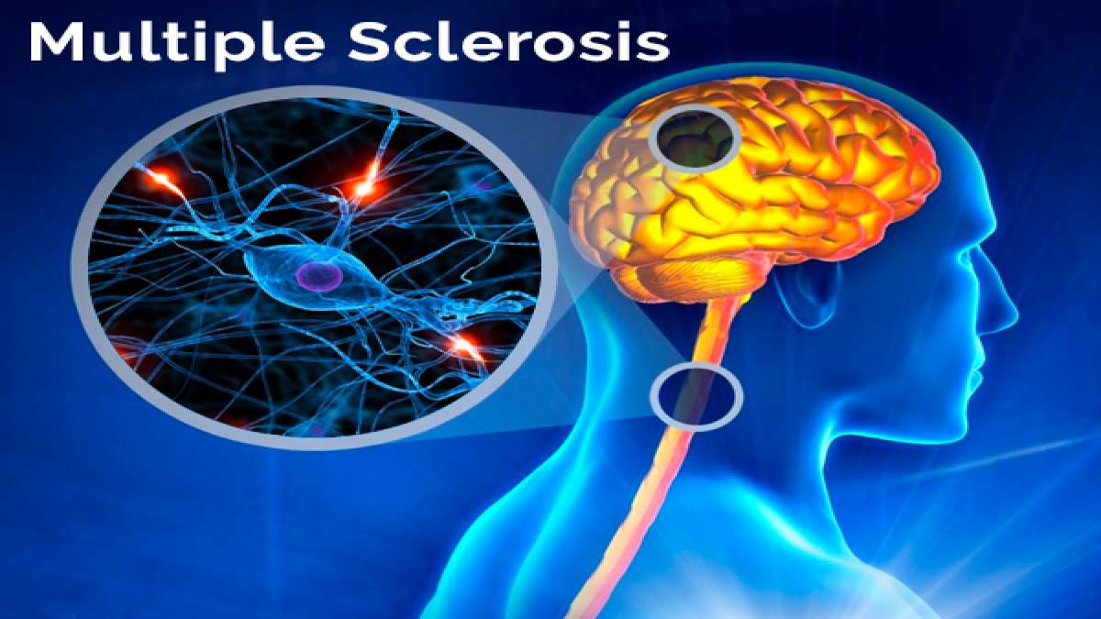
What is Multiple Sclerosis?
Multiple Sclerosis (MS) is the most common disabling neurological disease of young adults with symptom onset generally occurring between the ages of 20 to 40 years.
In MS, the immune system cells that normally protect us from viruses, bacteria, and unhealthy cells mistakenly attack myelin in the central nervous system (brain, optic nerves, and spinal cord). Myelin is a substance that makes up the protective sheath (myelin sheath) that coats nerve fibers (axons)
International Science Nutrition Society – CURARE CAUSAM - ISNS 2023

Slide 8
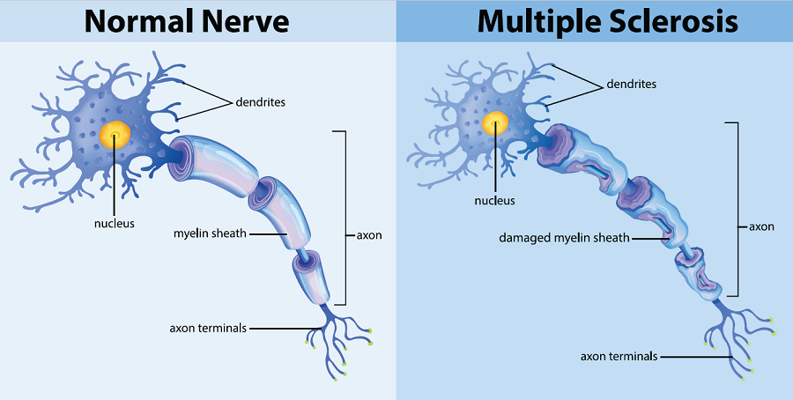
Multiple Sclerosis
Most people with MS, however, will have short periods of symptoms followed by long stretches of relative quiescence (inactivity or dormancy), with partial or full recovery. The disease is rarely fatal and most people with MS have a normal life expectancy
Most people with MS, however, will have short periods of symptoms followed by long stretches of relative quiescence (inactivity or dormancy), with partial or full recovery. The disease is rarely fatal and most people with MS have a normal life expectancy
International Science Nutrition Society – CURARE CAUSAM - ISNS 2023

Slide 9
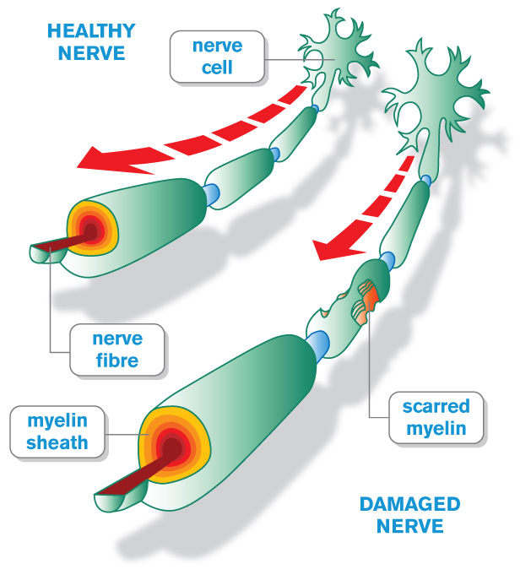
Myelin and the Immune System
MS attacks the axons in the central nervous system protected by myelin, which are commonly called white matter. MS also damages the nerve cell bodies, which are found in the brain’s gray matter, as well as the axons themselves in the brain, spinal cord, and optic nerves that transmit visual information from the eye to the brain. As the disease progresses, the outermost layer of the brain, called the cerebral cortex, shrinks in a process known as cortical atrophy.
The term multiple sclerosis refers to the distinctive areas of scar tissue (sclerosis- also called plaques or lesions) that result from the attack on myelin by the immune system. These plaques are visible using magnetic resonance imaging (MRI). Plaques can be as small as a pinhead or as large as a golf ball.
International Science Nutrition Society – CURARE CAUSAM - ISNS 2023

Slide 10
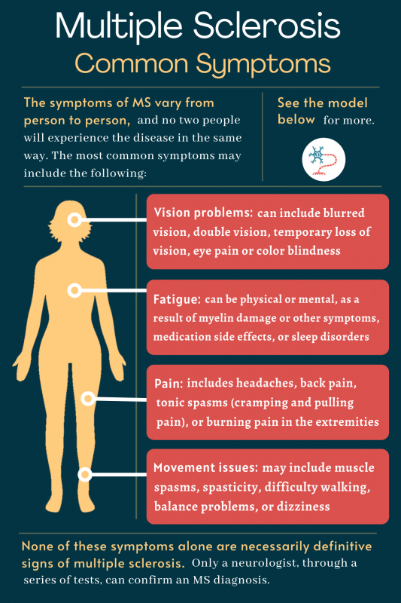
What are the symptoms of Multiple Sclerosis?
The symptoms of MS depend on the severity of the inflammatory reaction as well as the location and extent of the plaques, which primarily appear in the brain stem, cerebellum (involved with balance and coordination of movement, among other functions), spinal cord, optic nerves, and the white matter around the brain ventricles (fluid-filled cavities).
MS may also cause later symptoms such as:
Mental or physical fatigue which accompanies the early symptoms during an attack
Mood changes such as depression or difficulty with emotional expression or control
Cognitive dysfunction- problems concentrating, multitasking, thinking, learning, or difficulties with memory or judgment
International Science Nutrition Society – CURARE CAUSAM - ISNS 2023

Slide 11
Signs and Symptoms of MS
The natural course of MS is different for each person, which makes it difficult to predict. The onset and duration of MS symptoms usually depend on the specific type but may begin over a few days and go away quickly or develop more slowly and gradually over many years.
There are four main types of MS, namely according to the progression of symptoms over time:
Relapsing-remitting MS- symptoms of this type come as attacks. In between attacks, people recover or return to their usual level of disability. The periods of disease inactivity between MS attacks are referred to as remission. Weeks, months, or even years pass before another attack occurs, followed again by a period of inactivity. Most people with MS are initially diagnosed with this form of the disease.
Secondary-progressive MS– people with this form of MS usually have had a previous history of MS attacks but then start to develop gradual and steady symptoms and deterioration in their function over time. Most individuals with severe relapsing-remitting MS may go on to develop secondary progressive MS if they are untreated.
Primary-progressive MS – this type of MS is less common. It is characterized by progressively worsening symptoms from the beginning with no noticeable relapses or exacerbations of the disease, although there may be temporary or minor relief from symptoms.
Progressive-relapsing MS – the rarest form of MS, is characterized by a steady worsening of symptoms from the beginning, with acute relapses that can occur over time during the disease course.
International Science Nutrition Society – CURARE CAUSAM - ISNS 2023

Slide 12
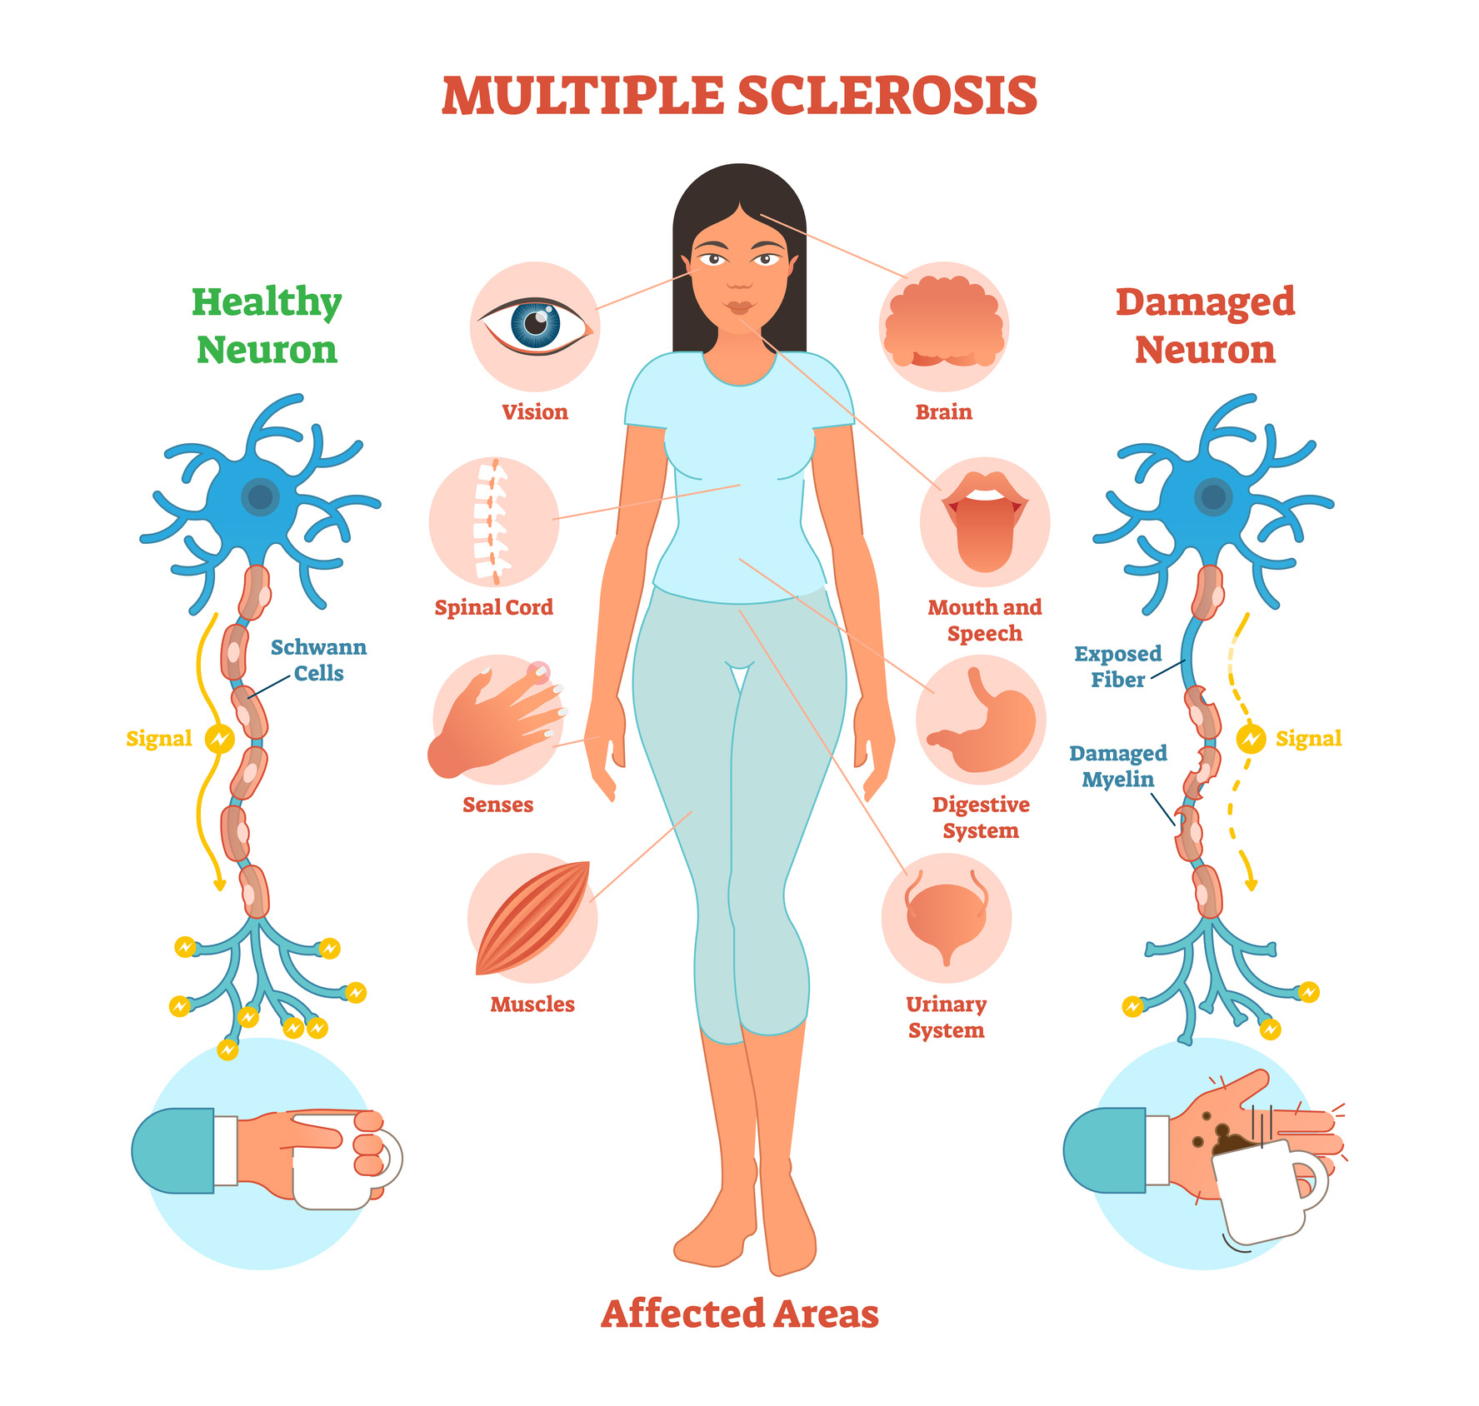
Later Symptoms of MS that may occur
Muscle weakness, stiffness, and spasms may be severe enough to affect walking or standing. In some cases, MS leads to partial or complete paralysis and using a wheelchair is not uncommon, particularly in individuals who are untreated or have advanced disease. Many people with MS find that weakness and fatigue are worse when they have a fever or when they are exposed to heat. MS exacerbations may occur following common infections.
Pain is rarely the first sign of MS, but pain often occurs with optic neuritis and trigeminal neuralgia, a disorder that affects one of the nerves that provides sensation to different parts of the face. Painful limb spasms and sharp pain shooting down the legs or around the abdomen can also be symptoms of MS
International Science Nutrition Society – CURARE CAUSAM - ISNS 2023

Slide 13
CASE STUDY
Patient: Female
Age: 45
History:
Multiplex Sclerosis was diagnosed 4 year ago
We met for the first time 5 months ago.
Medical history:
The diagnosis of the disease was confirmed by lumbar puncture and MRI
Symptoms:
Relapsing-remitting MS
She had attack at least once a month lasted several days, often 7-10 days. Even with steroid treatment.
She had a high degree of fatigue, her legs were numb, she had double vision, she was shaking, she was dizzy, she had abdominal pain.
International Science Nutrition Society – CURARE CAUSAM - ISNS 2023

Slide 14
Conventional Treatment
There is currently no cure for MS, but there are treatments that can reduce the number and severity of relapses and delay the long-term disability progression of the disease.
Corticosteroids, such as intravenous (infused into a vein) methylprednisolone, are given over the course of 3-5 days. IV steroids quickly and potently suppress the immune system and reduce inflammation.
Plasma exchange (plasmapheresis) can treat severe flare-ups in people with relapsing MS forms that do not respond well to methylprednisolone. Plasma exchange involves taking blood out of the body and removing the components in the blood’s plasma that are thought to be harmful.
------------------------------------------------------------------
She received biological therapy continuously.
International Science Nutrition Society – CURARE CAUSAM - ISNS 2023

Slide 15
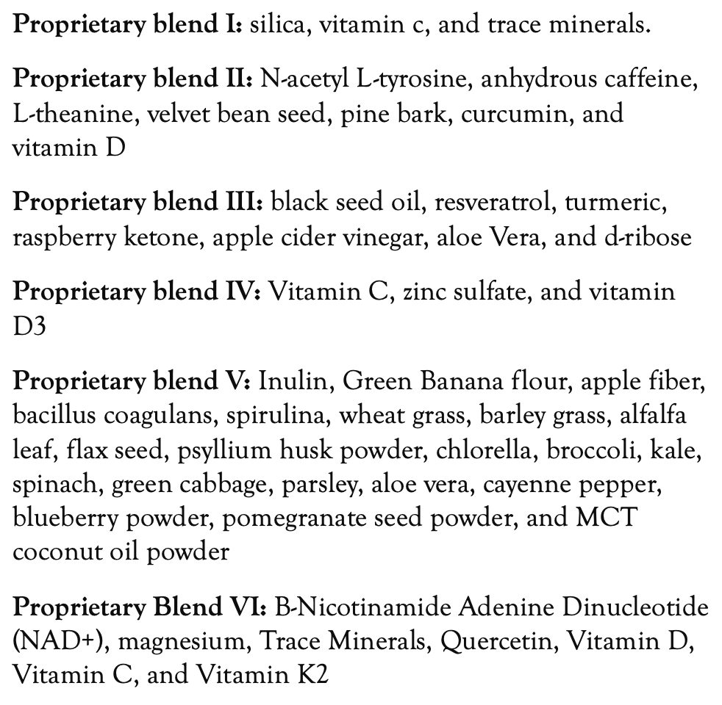
Method
PROPRIETARY BLENDS LEGEND
Proprietary blend I: 2x5 drops, morning and
evening, for 3 days, then every 3 days then
increased by 1-1 drops every 3 days to 2x12
Proprietary blend II :1 in the morning for 7 days, then 1 in the morning and 1 in the afternoon for 7 days, then 2 in the morning and 1 in the afternoon
Proprietary blend III: 1/2 sachet in the morning
for 7 days then 1 sachet in the morning, then 1 sachet in the morning and 1 sachet in the evening
Proprietary blend IV: 1 teaspoon in the morning
Proprietary blend V: 1 teaspoon in the
in the evening
Proprietary blend VI: 1 in the
morning for 7 days then 1 in the morning and 1 in the evening for 7 days, then 2 in the morning and 2 in the evening
International Science Nutrition Society – CURARE CAUSAM - ISNS 2023

Slide 16
Additional Treatment
A special diet based on my personal experience
Exercises to achieve a positive mental and emotional state (e.g: meditation, breathing exercises…)
International Science Nutrition Society – CURARE CAUSAM - ISNS 2023

Slide 17
Results
In the first month of treatment, the intensity of symptoms decreased already during the attack.
And great news is that the patient didn’t have relapse in the last 4 months!!!
Based on the control tests, the progression of the disease stopped.
International Science Nutrition Society – CURARE CAUSAM - ISNS 2023

Slide 18
Research Studies
International Science Nutrition Society – CURARE CAUSAM - ISNS 2023

Slide 19
Vitamin D for the treatment of multiple sclerosis: a meta-analysis Laurie McLaughlin, Laura Clarke, Elham Khalilidehkordi, Helmut Butzkueven, Bruce Taylor, Simon A Broadley
This study aimed to identify an association between latitude, relative vitamin D deficiency and risk of multiple sclerosis (MS), and an association between vitamin D and disease progression. We have performed a meta-analysis to investigate the role of therapeutic vitamin D in MS.
Results: Twelve studies involving 950 patients were included in the final analysis. Studies were divided into four groups because of heterogeneity in study design. Studies were judged to be at low or unclear risk of bias, except in three studies, which was confirmed by funnel plots. No statistically significant difference was seen for any of the outcome measures. There were non-significant trends favoring vitamin D for all outcome measures, particularly when only placebo-controlled studies were included. Dose comparison studies showed a significant increase in annualized relapse rate (mean difference 0.15 [95%CI 0.01-0.30]) and non-significant trends of increased Expanded Disability Status Scale and gadolinium-enhancing lesions for the higher-dose arms.
Conclusion: These findings suggest that vitamin D supplementation may be therapeutic in treating MS. However, there is uncertainty about the most appropriate dose, with high doses potentially being associated with worse outcomes. There remains the need for further well-performed randomized, dose-ranging, placebo-controlled trials of vitamin D in MS.
https://pubmed.ncbi.nlm.nih.gov/30284038/
International Science Nutrition Society – CURARE CAUSAM - ISNS 2023

Slide 20
Resveratrol Promotes Remyelination in Cuprizone Model of Multiple Sclerosis: Biochemical and Histological Study Heba R Ghaiad, Mohammed M Nooh, Maha M El-Sawalhi, Amria A Shaheen
Our study examined the potential neuroprotective and pro-remyelination effects of resveratrol in cuprizone-intoxicated C57Bl/6 mice. Mice were fed with chow containing 0.7 % cuprizone for 7 days, followed by 3 weeks on 0.2 % cuprizone diet. Resveratrol (250 mg/kg/day, p.o.) was given for 3 weeks starting from the second week.
At the end of the experiment, animals were tested on rotarod to evaluate changes in balance and motor coordination. Mice were then sacrificed to measure the brain content of glutathione, lipid peroxidation products, adenosine triphosphate, and phospho-inhibitory subunit of nuclear factor κB-α. The activities of cytochrome oxidase and superoxide dismutase were also assessed. The gene expression of myelin basic protein, 2',3'-cyclic nucleotide 3' phosphodiesterase, oligodendrocyte transcription factor-1 (Olig1), NF-κB p65 subunit, and tumor necrosis factor-α was also estimated.
In conclusion, Resveratrol effectively enhanced motor coordination and balance, reversed cuprizone-induced demyelination, improved mitochondrial function, alleviated oxidative stress, and inhibited NF-κB signaling. Interestingly, resveratrol increased Olig1 expression that is positively correlated to active remyelination. The present study may be the first to indicate a pro-remyelinative effect for resveratrol which might represent a potential additive benefit in treating MS.
https://pubmed.ncbi.nlm.nih.gov/27067589/
International Science Nutrition Society – CURARE CAUSAM - ISNS 2023

Slide 21
Nigella sativa ameliorates inflammation and demyelination in the experimental autoimmune encephalomyelitis-induced Wistar rats Neveen A Noor, Heba H Fahmy, Faten F Mohammed, Anwar A Elsayed, Nasr M Radwan.
The aim of the present study was to investigate the protective and ameliorative effects of N. sativa seeds (2.8 g/kg body weight) in EAE-induced Wistar rats. EAE-induced rats were divided into: 1- EAE-induced rats (“EAE” group). 2- “N. sativa + EAE” group received daily oral administration of N. sativa 2 weeks prior to EAE induction until the experiment’s end. 3- “EAE + N. sativa” group received daily oral administration of N. sativa after the appearance of the first clinical signs until the end of the experiment.
EAE was investigated using histopathological, immunohistochemical and ultrastructural examinations in addition to determining some oxidative stress parameters in the cerebellum and medulla. N. sativa suppressed inflammation observed in EAE-induced rats.
In Conclusion: N. sativa enhanced remyelination in the cerebellum. Moreover, N. sativa reduced the expression of transforming growth factor-beta 1 (TGF β1). N. sativa seeds could provide a promising agent effective in protecting and treating EAE.
https://www.ncbi.nlm.nih.gov/pmc/articles/PMC4525838/
International Science Nutrition Society – CURARE CAUSAM - ISNS 2023

Slide 22
References
https://www.ninds.nih.gov/health-information/disorders/multiple-sclerosis
https://www.hopkinsmedicine.org/health/conditions-and-diseases/multiple-sclerosis-ms
https://pubmed.ncbi.nlm.nih.gov/30284038/
https://pubmed.ncbi.nlm.nih.gov/27067589/
https://www.ncbi.nlm.nih.gov/pmc/articles/PMC4525838/
International Science Nutrition Society – CURARE CAUSAM - ISNS 2023

Slide 23
Thank You for Joining Us This Week!!
International Science Nutrition Society – CURARE CAUSAM - ISNS 2023

